Slide 1
ACIDS, BASES & SALTS
Notes:
CHEMISTRY RESOURCE 9C
M.ALI. SCIL, 2011-2012

Slide 2
T E R M S
  ACIDS are substances that form hydrogen ions (H⁺_{(aq)}) when dissolved in water eg
    Hydrochloric acid HCl gives H⁺_{(aq)} and C^{l-}_{(aq)} ions,
    Sulphuric acid H₂SO₄ gives 2H⁺_{(aq)} and SO₄²⁻ ions
    Nitric acid HNO₃ gives H⁺_{(aq)} and NO₃⁻_{(aq)} ions.
BASES are oxides and hydroxides of metals that react and neutralise acids to form salts and water only. Bases which are soluble in water are called alkalis. Not all bases fit into these categories e.g. ammonia.
  Alkalis are substances that form hydroxide ions OH⁻_{(aq)} in water eg
    Sodium Hydroxide NaOH gives Na⁺_{(aq)} and OH⁻_{(aq)} ions,
    Calcium Hydroxide Ca(OH)₂ gives Ca²⁺_{(aq)} and 2OH⁻_{(aq)} ions.
ہفتہ, 7, نومبر 2026
Topic 10: ACIDS, BASES & SALTS
Notes:
CHEMISTRY RESOURCE 9C
M.ALI. SCIL, 2011-2012

Slide 3
  In acid solutions there are more H⁺ ions than OH⁻ ions.
  In alkaline solution there are more OH⁻ ions than H⁺ ions.
  Acids that dissociate (ionize) to a large extent are strong electrolytes and Strong Acids.
  Acids that dissociate only to a small extent are Weak Acids and weak electrolytes
Bases can be strong or weak depending on the extent to which they dissociate and produce OH– ions in solution. Most metal hydroxides are strong electrolytes and Strong Bases. Ammonia, NH₃, is a weak electrolyte and Weak Base.
ہفتہ, 7, نومبر 2026
Topic 10: ACIDS, BASES & SALTS

Slide 4
Basicity of Acid
It is the number of ionizable H⁺ ions present in an acid e.g.
HCl is mono basic, it ionizes to produce one H⁺ ion
HCl ⬅==============➔ H⁺ + Cl⁻
H₂SO₄ is Dibasic, It ionizes to produce two H⁺ ions.
H₂SO₄ ⬅===============➔ 2H⁺ + SO₄²⁻
H₃PO₄ is Tribasic, it ionizes to produce three H⁺ ions.
H₃PO₄ ⬅==============➔ 3H⁺ + PO₄³⁻
ہفتہ, 7, نومبر 2026
Topic 10: ACIDS, BASES & SALTS

Slide 5
Acidity of a Base
It is the ionizable OH⁻ ions present in an alkali. e.g.
NaOH is monoacidic
NaOH ⬅==========➔ Na⁺ + OH⁻
Ca(OH)₂ is diacidic
Ca(OH)₂ ⬅==============➔ Ca²⁺ + 2OH⁻
ہفتہ, 7, نومبر 2026
Topic 10: ACIDS, BASES & SALTS

Slide 6
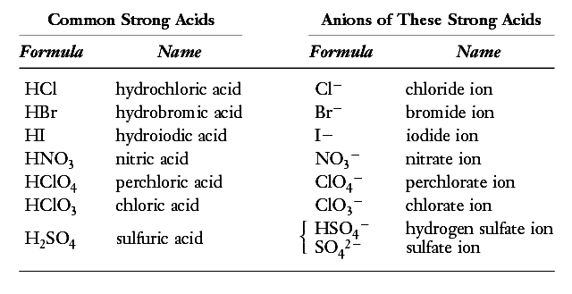
Common Strong Acids & their Anions
ہفتہ, 7, نومبر 2026
Topic 10: ACIDS, BASES & SALTS

Slide 7
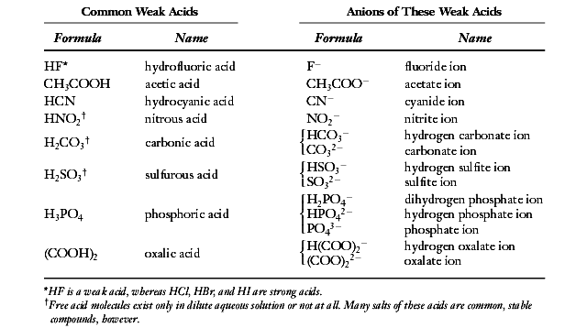
Common Weak Acids & their Anions
ہفتہ, 7, نومبر 2026
Topic 10: ACIDS, BASES & SALTS

Slide 8
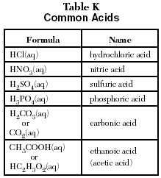
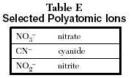
Naming of Acids
Binary Acids (H⁺ and a nonmetal)
  hydro (nonmetal) -ide + ic acid
    HCl (aq) = hydrochloric acid
Ternary Acids (H⁺ and a polyatomic ion)
  (polyatomic ion) -ate +ic acid
    HNO₃ (aq) = nitric acid
  (polyatomic ion) -ide +ic acid
    HCN (aq) = cyanic acid
  (polyatomic ion) -ite +ous acid
    HNO₂ (aq) = nitrous acid
ہفتہ, 7, نومبر 2026
Topic 10: ACIDS, BASES & SALTS

Slide 9
Formula Writing of Acids
Acids formulas get written like any other. Write the H⁺¹ first, then figure out what the negative ion is based on the name. Cancel out the charges to write the formula. Don’t forget the (aq) after it…it’s only an acid if it’s in water!
Carbonic acid: H⁺¹ and CO₃⁻² = H₂CO₃ (aq)
Chlorous acid: H⁺¹ and ClO₂⁻¹ = HClO₂ (aq)
Hydrobromic acid: H⁺¹ and Br⁻¹ = HBr (aq)
Hydronitric acid:
ہفتہ, 7, نومبر 2026
Topic 10: ACIDS, BASES & SALTS

Slide 10
Properties of Bases
Bases react with fats to form soap and glycerol. This process is called saponification.
Bases have a pH of more than 7.
Dilute solutions of bases taste bitter.
Bases turn phenolphthalein PINK, litmus BLUE and bromthymol blue BLUE.
Bases neutralize acids.
Bases are formed when alkali metals or alkaline earth metals react with water. The words “alkali” and “alkaline” mean “basic”, as opposed to “acidic”.
ہفتہ, 7, نومبر 2026
Topic 10: ACIDS, BASES & SALTS

Slide 11
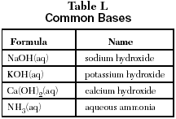


Naming of Bases
Bases are named like any ionic compound, the name of the metal ion first (with a Roman numeral if necessary) followed by “hydroxide”.
Fe(OH)₂ (aq) = iron (II) hydroxide
Fe(OH)₃ (aq) = iron (III) hydroxide
Al(OH)₃ (aq) = aluminum hydroxide
NH₃ (aq) is the same thing as NH₄OH:
NH₃ + H₂O → NH₄OH
Also called ammonium hydroxide.
ہفتہ, 7, نومبر 2026
Topic 10: ACIDS, BASES & SALTS

Slide 12
Formula Writing of Bases
Formula writing of bases is the same as for any ionic formula writing. The charges of the ions have to cancel out.
Calcium hydroxide = Ca⁺² and OH⁻¹ = Ca(OH)₂ (aq)
Potassium hydroxide = K⁺¹ and OH⁻¹ = KOH (aq)
Lead (II) hydroxide = Pb⁺² and OH⁻¹ = Pb(OH)₂ (aq)
Lead (IV) hydroxide = Pb⁺⁴ and OH⁻¹ = Pb(OH)₄ (aq)
Lithium hydroxide =
Copper (II) hydroxide =
Magnesium hydroxide =
ہفتہ, 7, نومبر 2026
Topic 10: ACIDS, BASES & SALTS

Slide 13
Physical Properties of Acids & Bases
ACIDS
Acids taste sour (e.g. vinegar, lemon juice).
Acids are harmful to living cells.
Aqueous solutions of all acids contain hydrogen ions.
Acid turns blue litmus red.
Strong acids are corrosive.
BASES
Alkalis are taste bitter
Strong alkalis are corrosive.
Aqueous solutions of all alkalis contain hydroxide ion.
Alkalis turns red litmus blue.
Soapy touch.
ہفتہ, 7, نومبر 2026
Topic 10: ACIDS, BASES & SALTS

Slide 14
Chemical Properties of Acids
With metals
Metals above copper in the reactivity series will react with acids, giving off hydrogen gas, forming a salt.
Mg_{(s)} + H₂SO_{4(aq)} → MgSO_{4(aq)} + H_{2(g)}
With bases (metal oxides and hydroxides)
The base dissolves in the acid and neutralises it. A salt is formed.
H₂SO_{4(aq)} + CuO_{(s)} → CuSO_{4(aq)} + H₂O_{(l)}
With metal carbonates
With metal carbonates, effervescence occurs, salt, water and carbon dioxide gas is produced.
2HCl_{(aq)} + CaCO_{3(s)} → CaCl_{2(s)} + H₂O_{(l)} + CO_{2(g)}
ہفتہ, 7, نومبر 2026
Topic 10: ACIDS, BASES & SALTS

Slide 15
Neutralization
H⁺¹ + OH⁻¹ → HOH
Acid + Base → Water + Salt (double replacement)
HCl (aq) + NaOH (aq) → HOH (l) + NaCl (aq)
H₂SO₄ (aq) + KOH (aq) → 2 HOH (l) + K₂SO₄ (aq)
HBr (aq) + LiOH (aq) →
H₂CrO₄ (aq) + NaOH (aq) →
HNO₃ (aq) + Ca(OH)₂ (aq) →
H₃PO₄ (aq) + Mg(OH)₂ (aq) →
ہفتہ, 7, نومبر 2026
Topic 10: ACIDS, BASES & SALTS

Slide 16
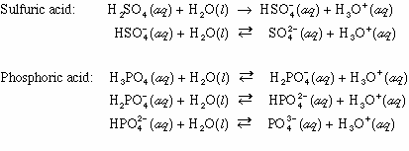
Formation of Hydronium ion( H₃0⁺).
The hydrogen ion H⁺_{(aq)} does not exist as such in aqueous solutions. Hydrogen ions combine with water molecules to give a more stable species, the hydronium ion H_{3O}⁺.
HCl_{(aq)} + H₂O_{(l) < =========➔} H₃O⁺_{(aq)} + Cl⁻_{(aq)}
Acids can contain different numbers of acidic hydrogens, and can yield different numbers of H₃O⁺ ions in solution.
ہفتہ, 7, نومبر 2026
Topic 10: ACIDS, BASES & SALTS

Slide 17
USES OF ACIDS
HCl in stomach
H₂SO₄ in car batteries, as drying agent’
HNO₃ in manufacturing of fertilizers
Ethanoic acid in food industry
Fatty acids in soap making
Ascorbic acid in medicine
ہفتہ, 7, نومبر 2026
Topic 10: ACIDS, BASES & SALTS

Slide 18
Chemical Properties of Bases
Neutralisation.
Ammonium salts are decomposed when mixed with a base eg sodium hydroxide. The ammonia is readily detected by its pungent odour (strong smell) and by turning damp red litmus blue.
  NaOH + NH₄Cl ==> NaCl + H₂O + NH₃
  Ionically: NH₄⁺ + OH⁻ ==> H₂O + NH₃
  This reaction can be used to prepare ammonia gas and as a test for an ammonium salt.
ہفتہ, 7, نومبر 2026
Topic 10: ACIDS, BASES & SALTS

Slide 19
Chemical Properties of Bases
Alkali's are used to produce the insoluble hydroxide precipitates of many metal ions from their soluble salt solutions.
2NaOH_{(aq)} + CuSO_{4(aq)} ==> Na₂SO_{4(aq)} + Cu(OH)_{2(s)}
  ionically: Cu²⁺_{(aq)} + 2OH⁻_{(aq)} ==> Cu(OH)_{2(s)}
This reaction can be used as a simple test to help identify certain metal ions.
ہفتہ, 7, نومبر 2026
Topic 10: ACIDS, BASES & SALTS

Slide 20
TYPES OF OXIDES
  :
    BASIC OXIDES
    On the left and middle of the Periodic Table are the basic metal oxides eg Na₂O, MgO, CuO etc
    They react with acids to form salts. e.g
    2HCl + MgO ------------→ MgCl₂ + H₂O
    CuO + H₂SO₄ -------------→ CuSO₄ + H₂O
    These metal oxides tend to be ionic in bonding character with high melting points.
    As you move left to right the oxides become less basic and more acidic.
ہفتہ, 7, نومبر 2026
Topic 10: ACIDS, BASES & SALTS

Slide 21
TYPES OF OXIDES
    ACIDIC OXIDES: On the right of the Periodic Table the acidic oxides of the non-metals are present e.g. CO₂, P₂O₅, SO₂, SO₃ etc.
    These tend to be covalent in bonding character with low melting/boiling points.
    Those of sulphur and phosphorus are very soluble in water to give acidic solutions which can be neutralised by alkalis to form salts.
    SO₂ + H₂O -----------→ H₂SO₃
    SO₃ + H₂O -----------→ H₂SO₄
ہفتہ, 7, نومبر 2026
Topic 10: ACIDS, BASES & SALTS

Slide 22
TYPES OF OXIDES
    AMPHOTERIC OXIDES:
    They are metallic oxides.
    They react with both acids and alkalis.
    They are usually relatively insoluble and have little effect on indicators.
    An example is aluminium oxide dissolves in acids to form 'normal' aluminium salts like the chloride, sulphate and nitrate. However, it also dissolves in strong alkali's like sodium hydroxide solution to form 'aluminate' salts.
ہفتہ, 7, نومبر 2026
Topic 10: ACIDS, BASES & SALTS

Slide 23
TYPES OF OXIDES
    NEUTRAL OXIDES:
    They are non- metallic oxides.
    They tend to be of low solubility in water and have no effect on litmus.
    do not react with acids or alkalis. eg CO carbon monoxide and NO nitrogen monoxide, H₂O.
    There is no way of simply predicting this kind of behavior from periodic table patterns!
ہفتہ, 7, نومبر 2026
Topic 10: ACIDS, BASES & SALTS

Slide 24
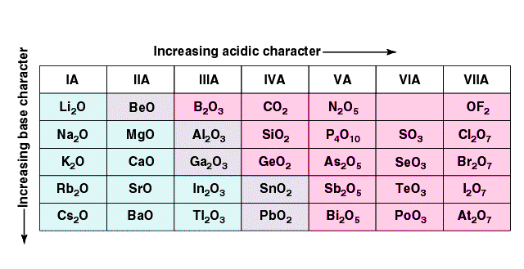
PERIODIC TRENDS IN OXIDES
ہفتہ, 7, نومبر 2026
Topic 10: ACIDS, BASES & SALTS

Slide 25
SALTS
When H⁺ ion of an acid is replaced by a metal ion, a salt is produced e.g.
H₂SO_{4(aq)} + 2NaOH_{(aq)} ⬅======➔ Na₂SO_{4(aq)} + 2H₂O_{(l)}
Here sodium sulphate (Na₂SO₄) is the salt formed. Salts are ionic compounds.
Note: Ammonia (NH₃) is an unusual base - it does not contain a metal. It forms ammonium salts, containing the ammonium ion, NH₄⁺.
e.g. NH_{3(aq)} + HNO_{3(aq)} → NH₄NO_{3(aq)} (ammonium nitrate)
ہفتہ, 7, نومبر 2026
Topic 10: ACIDS, BASES & SALTS

Slide 26
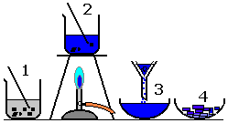
Methods of making Soluble Salts
ACID + METAL → SALT + HYDROGEN
2) ACID + BASE → SALT + WATER
3) ACID + CARBONATE → SALT + WATER + CARBON DIOXIDE
ACID + ALKALI → SALT + WATER
DIRECT COMBINATION
ہفتہ, 7, نومبر 2026
Topic 10: ACIDS, BASES & SALTS

Slide 27
Method 1 (Acid + Metal)
Not suitable for making salts of metals above magnesium, or below iron/tin in reactivity.
e.g.
    Zn + 2HCl -------------------→ ZnCl₂ + H₂
    Fe + H₂SO₄ ----------------→ FeSO₄ + H₂
Method 2 (Acid + Base)
Useful for making salts of less reactive metals, e.g. lead, copper.
e.g.
    CuO + H₂SO₄ ----------------→ CuSO₄ + H₂O
    MgO + 2HCl ------------------→ MgCl₂ + H₂O
Add excess base to acid.
ہفتہ, 7, نومبر 2026
Topic 10: ACIDS, BASES & SALTS

Slide 28
Method 3 (Acid + Carbonate)
Useful particularly for making salts of more reactive metals, e.g. calcium, sodium.
e.g.
    CaCO₃ + 2HCl -------------→ CaCl₂ + H₂O + CO₂.
    Na₂CO₃ + H₂SO₄ ------------→ Na₂SO₄ + H₂O + CO₂.
Method 4 (Acid + Alkali)
This is useful for making salts of reactive metals, and ammonium salts. It is different from methods 1-3, as both reactants are in solution. This means neutralisation must be achieved, by adding exactly the right amount of acid to neutralise the alkali. This can be worked out by titration
e.g.
    NaOH + HCl --------------→ NaCl + H₂O
    2NH₄OH + H₂SO₄ ----------------------→ (NH₄)₂SO₄ + 2H₂O
ہفتہ, 7, نومبر 2026
Topic 10: ACIDS, BASES & SALTS

Slide 29
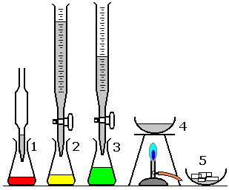
ہفتہ, 7, نومبر 2026
Topic 10: ACIDS, BASES & SALTS

Slide 30
Making Insoluble Salts
This involves mixing solutions of two soluble salts that between them contain the ions that make up the insoluble salt. It is made by two methods.
  PRECIPITATION
    BaCl_{2(aq)} + MgSO_{4(aq)} → BaSO_{4(s)} + MgCl_{2(aq)}
  DIRECT COMBINATION
    Fe + S ---heat----→ FeS
ہفتہ, 7, نومبر 2026
Topic 10: ACIDS, BASES & SALTS

Slide 31
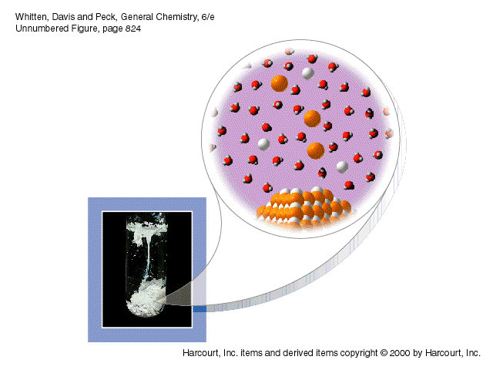
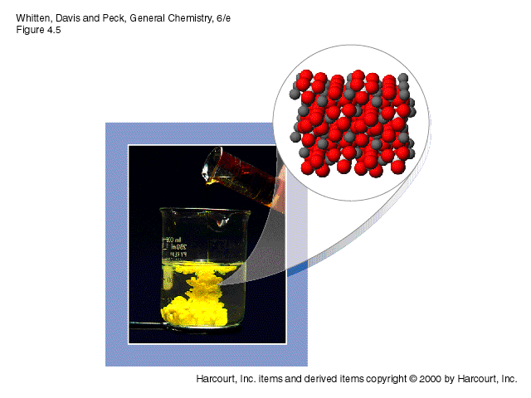
PRECIPITATION REACTION
ہفتہ, 7, نومبر 2026
Topic 10: ACIDS, BASES & SALTS

Slide 32
Types of Salts
Normal Salts:
Normal salts are formed when all the replaceable hydrogen ions in the acid have been completely replaced by metallic ions.
HCl_{(aq)} + NaOH_{(aq)} → NaCl_{(aq)} + H₂O_{(l)}
H₂SO_{4(aq)} + ZnO_{(aq)} → ZnSO_{4(aq)} + H₂O_{(l)}
Normal salts are neutral to litmus paper.
ہفتہ, 7, نومبر 2026
Topic 10: ACIDS, BASES & SALTS

Slide 33
Acid salts:
Acid salts are formed when replaceable hydrogen ions in acids are only partially replaced by a metal. Acid salts are produced only by acids containing more then one replaceable hydrogen ion. Therefore an acid with two replaceable ions e.g. H₂SO₄ will form only one acid salt, while acid with three replaceable hydrogen ions e.g. H₃PO₄ will form two different acid salts.
H₂SO_{4(aq)} + KOH_{(aq)} → KHSO_{4(aq)} + H₂O_{(l)}
H₃PO_{4(aq)} + NaOH → NaH₂PO_{4(aq)} + H₂O_{(l)}
H₃PO_{4(aq)} + 2NaOH_{(aq)} → Na₂HPO_{4(aq)} + 2H₂O_{(l)}
An acid salt will turn blue litmus red. In the presence of excess metallic ions an acid salt will be converted into a normal salt as its replaceable hydrogen ions become replaced.
KHSO_{4(aq)} + KOH ⬅================➔ K₂SO_{4(aq)} + H+O_{(l)}
ہفتہ, 7, نومبر 2026
Topic 10: ACIDS, BASES & SALTS

Slide 34
Basic Salts:
Basic salts contain the hydroxide ion, OH-. They are formed when there is insufficient supply of acid for the complete neutralization of the base. A basic salt will turn red litmus blue and will react with excess acid to form normal salt.
  Zn(OH)_{2(s)} + HCl_{(aq)} → Zn(OH)Cl_{(aq)} + H₂O_{(l)}
  Zn(OH)Cl_{(aq)} + HCl_{(aq)} → ZnCl_{2(aq)} + H₂O_{(l)}
  Mg(OH)_{2(s)} + HNO_{3(aq)} → Mg(OH)NO_{3(aq)} + H₂O_{(l)}
  Mg(OH)NO_{3(aq)} + HNO_{3(aq)} → Mg(NO₃)_{2(aq)} + H₂O_{(l)}
ہفتہ, 7, نومبر 2026
Topic 10: ACIDS, BASES & SALTS

Slide 35
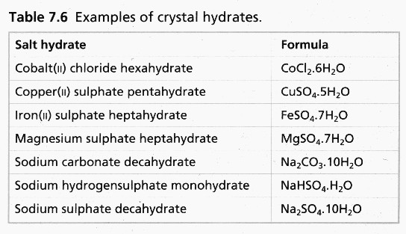
HYDRATED & ANHYDROUS SALTS
Hydrated Salt: Salt that contains Water of Crystallization is called Hydrated Salt e.g. CuSO₄.5H₂O, Na₂CO₃.10H₂O.
Anhydrous Salt: Salt with out Water of Crystallization is called Anhydrous Salt. e.g. CuSO_{4,} Na₂CO₃
ہفتہ, 7, نومبر 2026
Topic 10: ACIDS, BASES & SALTS

Slide 36
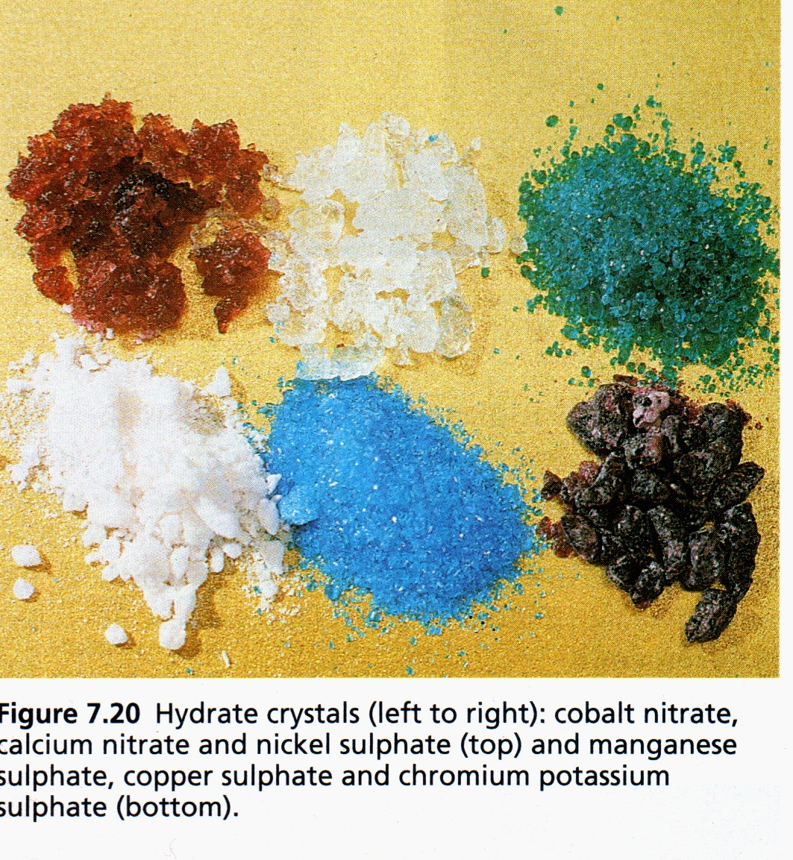
ہفتہ, 7, نومبر 2026
Topic 10: ACIDS, BASES & SALTS

Slide 37
USES OF SALTS
S.No. | SALT | USE
1 | Ammonium Chloride | In torch batteries
2 | Ammonium Nitrate | In fertilizers
3 | Calcium Chloride | As drying agent
4 | Iron Sulphate | In Iron tablets
5 | Magnesium Sulphate | In medicine
6 | Potassium Nitrate | In gunpowder etc.
7 | Silver Bromide | In photography
8 | Sodium Chloride | Making NaOH
9 | Sodium Stearate | In making soap.
ہفتہ, 7, نومبر 2026
Topic 10: ACIDS, BASES & SALTS

Slide 38
Self Ionization of Water
Pure water is often used as an example of non- conducting liquid. In fact water will conduct electricity if there is sufficient electrical energy present. The fact that pure water conduct electricity suggest that it contains ions. The ions present are due to water undergoing self ionization.
2H₂O_{(l)} ⬅==========➔ H₃O⁺_{(aq)} + OH⁻ _{(aq)}
The concentration of H₃O⁺ ions in pure water at 25ºC is 10⁻⁷ moles/dm³. The concentration of OH⁻ ion should also be 10⁻⁷ moles/dm³.
ہفتہ, 7, نومبر 2026
Topic 10: ACIDS, BASES & SALTS

Slide 39

The pH Scale
ہفتہ, 7, نومبر 2026
Topic 10: ACIDS, BASES & SALTS

Slide 40
The pH scale is a measure of the relative acidity or alkalinity of a solution.
It is defined as negative log of H⁺ ion concentration.
pH = -log [H⁺]
Water is a neutral liquid with a pH of 7 (green). When a substance dissolves in water it forms an aqueous solution that may be acidic, neutral or alkaline.
Acidic solutions have a pH of less than 7, and the lower the number, the stronger the acid is..
Neutral solutions have a pH of 7. These are quite often solutions of salts, which are themselves formed from neutralizing acids and bases.
Alkaline solutions have a pH of over 7 and the higher the pH the stronger is the alkali. Weak alkalis like ammonia give a pH of 10-11 but strong alkalis like sodium hydroxide give a pH of 13-14.
ہفتہ, 7, نومبر 2026
Topic 10: ACIDS, BASES & SALTS

Slide 41
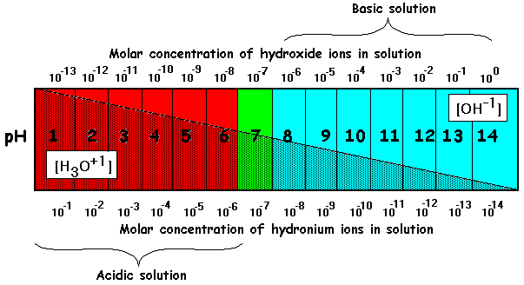
pH
A change of 1 in pH is a tenfold increase in acid or base strength.
A pH of 4 is 10 times more acidic than a pH of 5.
A pH of 12 is 100 times more basic than a pH of 10.
ہفتہ, 7, نومبر 2026
Topic 10: ACIDS, BASES & SALTS

Slide 42
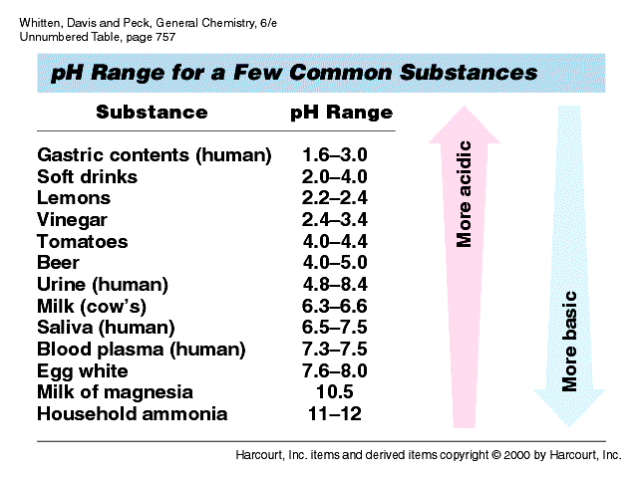
ہفتہ, 7, نومبر 2026
Topic 10: ACIDS, BASES & SALTS

Slide 43
INDICATORS.
Indicators are the substances that have different colors in acidic and in alkaline solution.
S.No. | Indicator | Color in strong acidic solution | pH at which color change | Color in strong alkaline solution
1 | Methyle orange | Red | 4 | Yellow
2 | Bromothymol blue | Yellow | 7 | Blue
3 | Phenolphthalein | Colorless | 9 | Red
4 | Screened methyl orange | Red | 4 | Green
ہفتہ, 7, نومبر 2026
Topic 10: ACIDS, BASES & SALTS

Slide 44
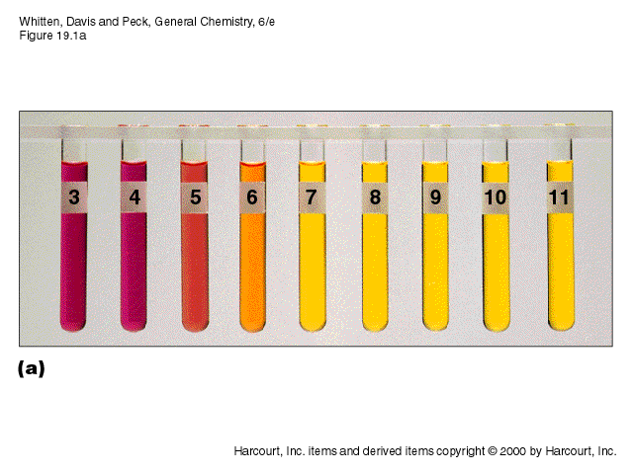
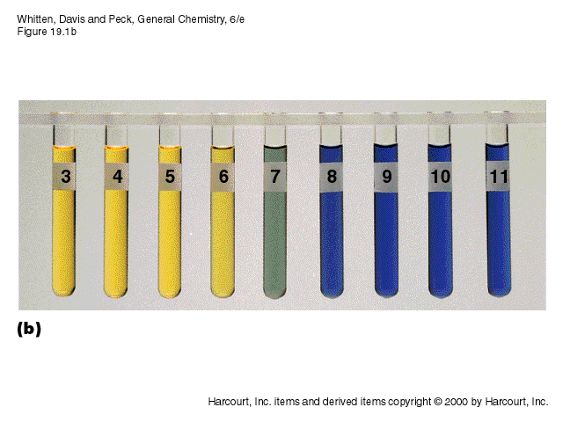
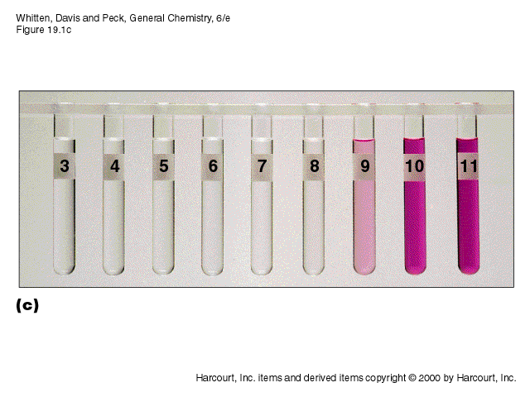
ہفتہ, 7, نومبر 2026
Topic 10: ACIDS, BASES & SALTS

Slide 45
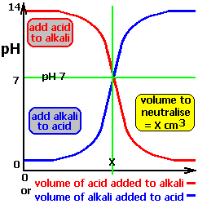
pH Graph
ہفتہ, 7, نومبر 2026
Topic 10: ACIDS, BASES & SALTS

Slide 46
IONIC EQUATIONS
In many reactions only certain ions change their 'chemical state' but other ions remain in exactly the same original physical and chemical state.
The ions that do not change are called 'spectator ions'.
The ionic equation represents the 'actual' chemical change and omits the spectator ions.
To write a net ionic equation:
    Write a balanced molecular equation.
    Rewrite the equation showing the ions that form in solution when each soluble electrolyte dissociates into its component ions. Only dissolved strong electrolytes are written in ionic form.
    Identify and cancel the spectator ions that occur unchanged on both sides of the equation.
    Write correct state symbols.
ہفتہ, 7, نومبر 2026
Topic 10: ACIDS, BASES & SALTS

Slide 47
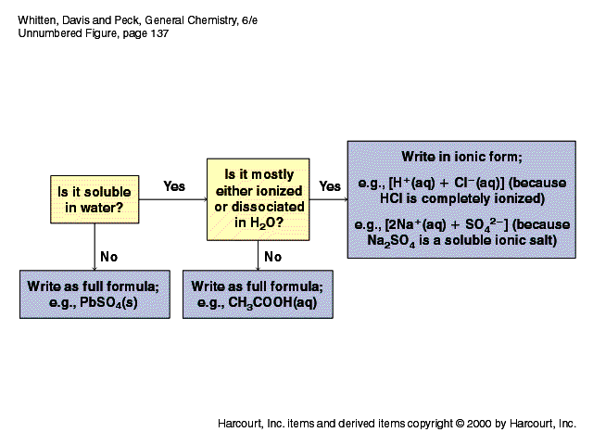
SCHEME FOR IONIC EQUATION
ہفتہ, 7, نومبر 2026
Topic 10: ACIDS, BASES & SALTS

Slide 48
THE END
ہفتہ, 7, نومبر 2026
Topic 10: ACIDS, BASES & SALTS
Notes:
M.ALI. SCIL, 2011-2012
CHEMISTRY RESOURCE 9C

